Slide 1
ASU ASCEND
Mason Denney
Mentored By
Thomas Sharp

Slide 2
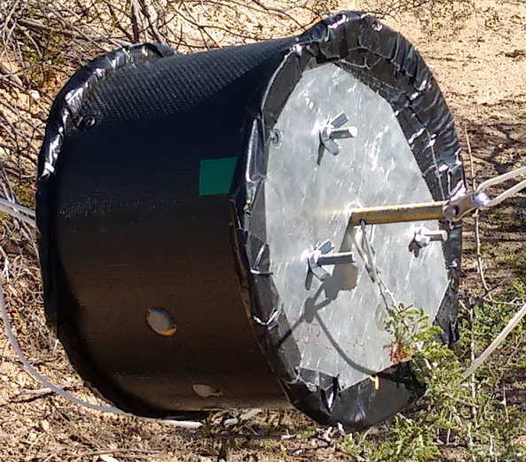
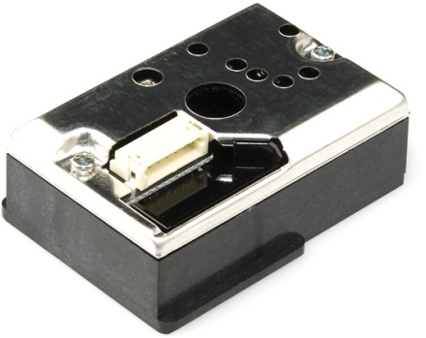
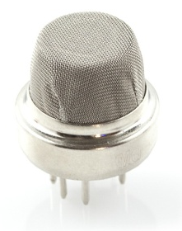
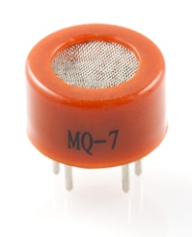
Fall Summary
Cylinder fuselage
Dust sensor debut
3 HD Wings (up, down, side)
Side gas sensors
MQ6 (LPG)
MQ7 (CO)
MQ4 (Methane)
Spike

Slide 3
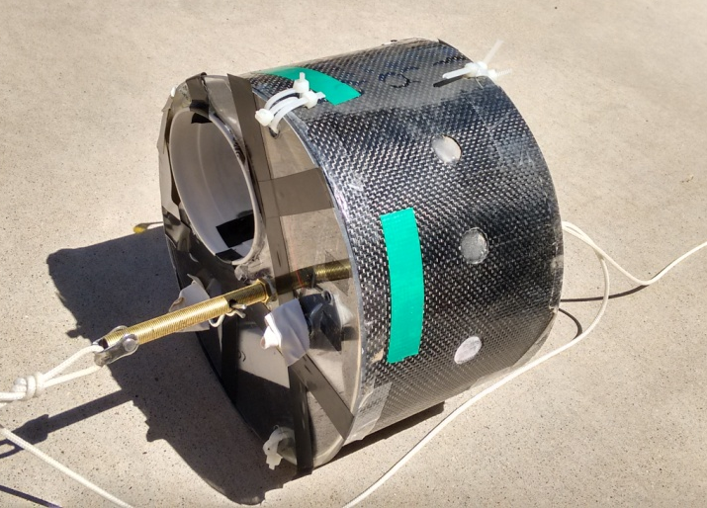
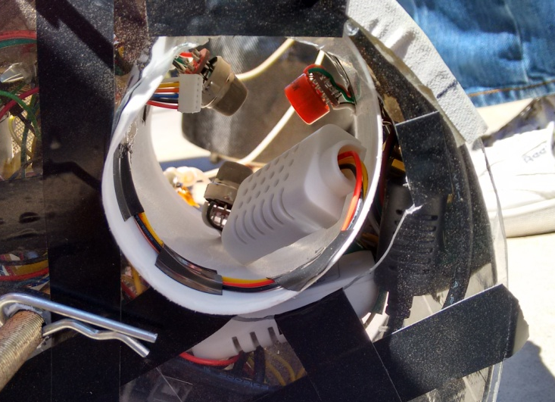
Spring Overview
Tunnel fuselage
Sensor Modules
Gas Module
LPG, CO, Methane
Dust Module
Sharp optical dust sensor
Light sensor
Compact humidity
Cameras
HD Wing
Android + Seek

Slide 4
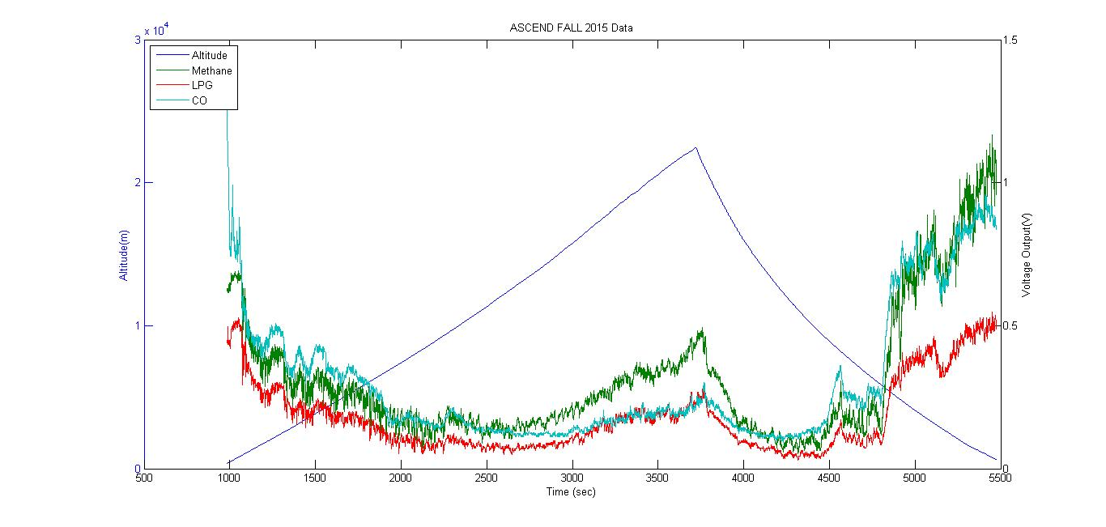
Fall Gas Module: Gas

Slide 5
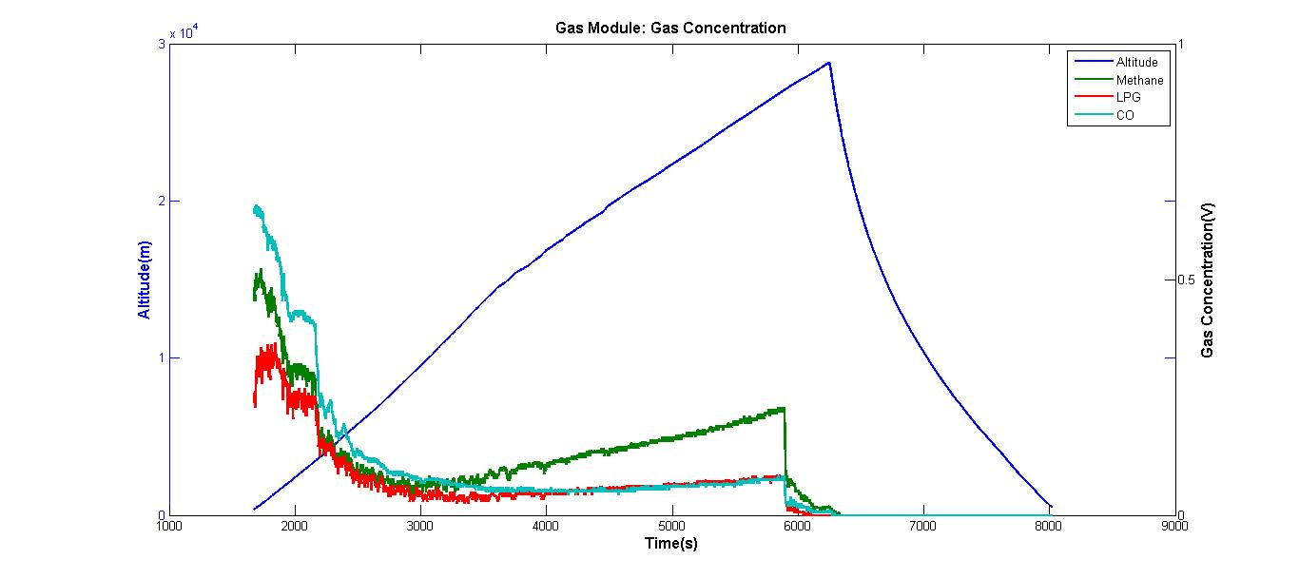
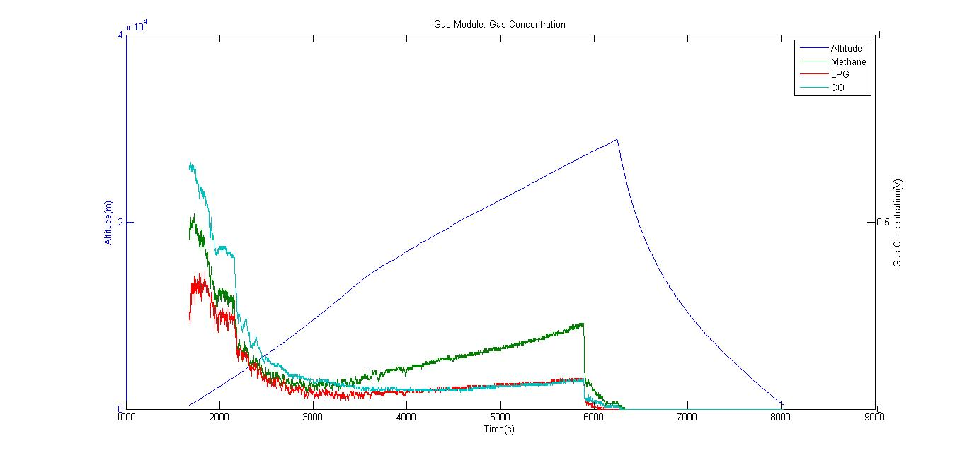
Spring Gas Module: Gas

Slide 6
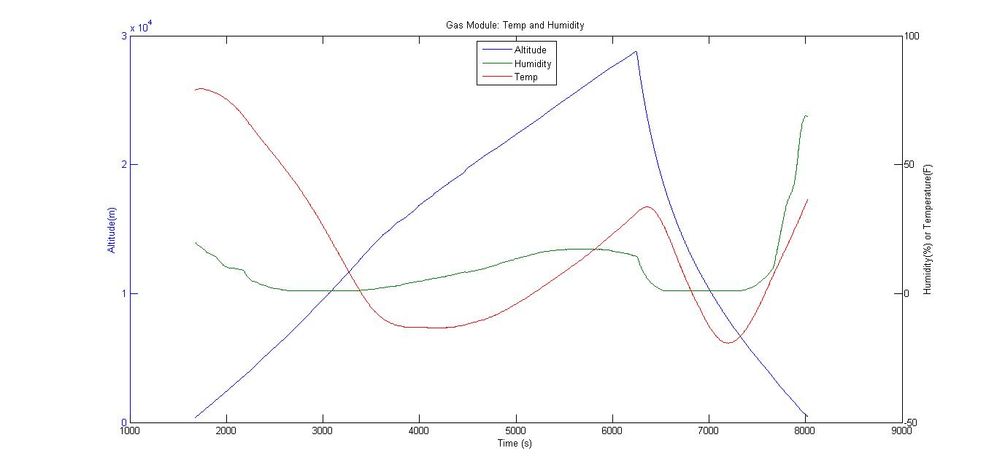
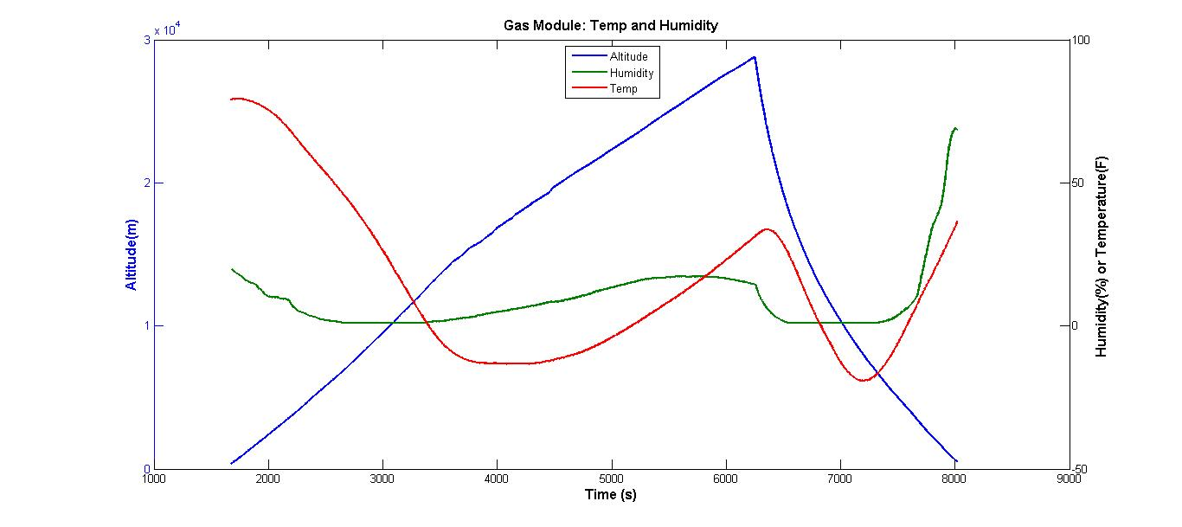
Spring Gas Module: Temp/Hum

Slide 7
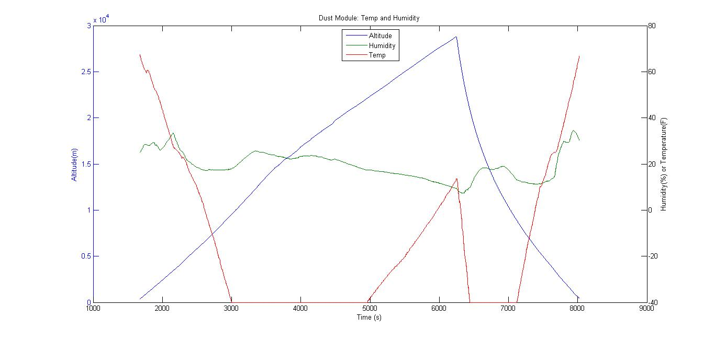
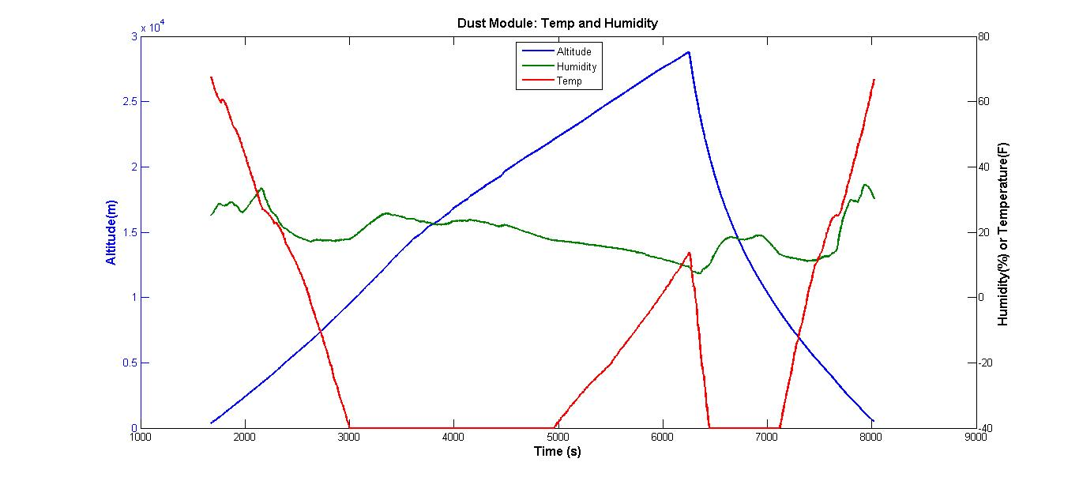
Spring Dust Module: Temp/Hum

Slide 8
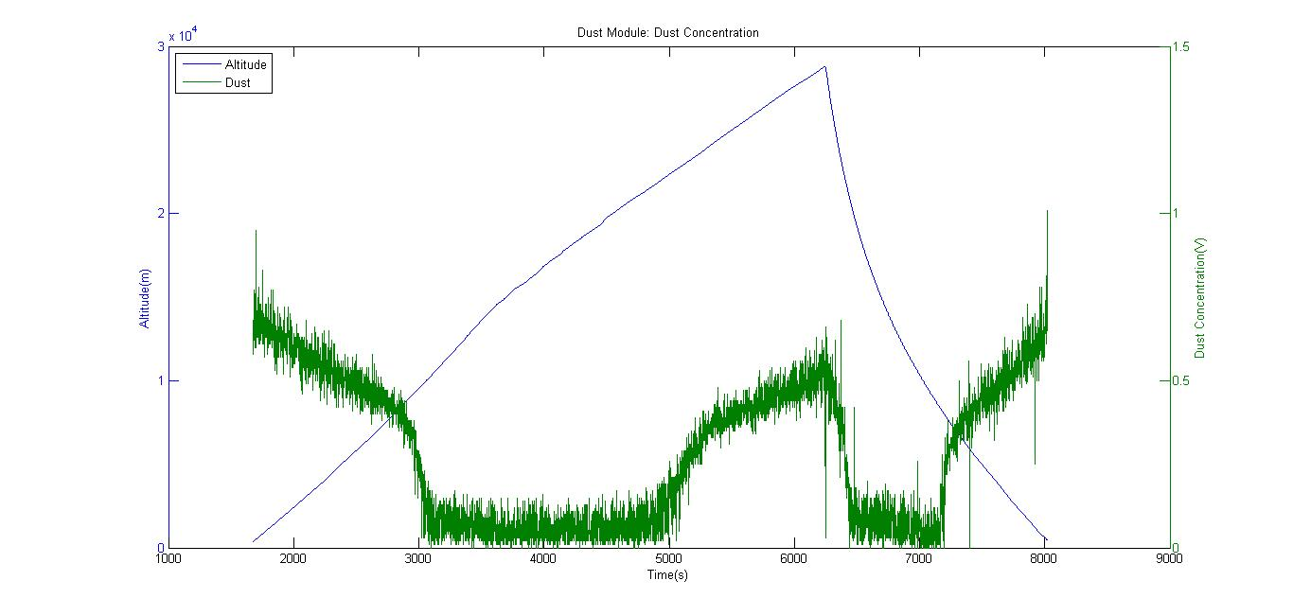
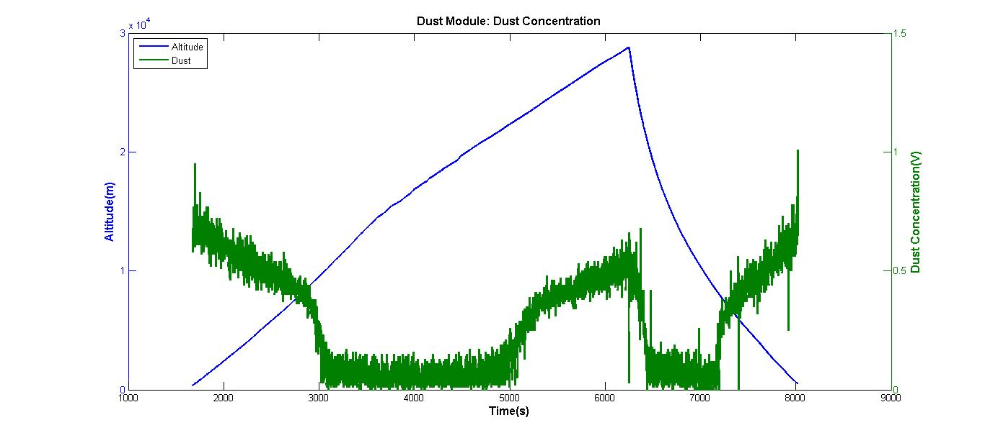
Spring Dust Module: Dust

Slide 9
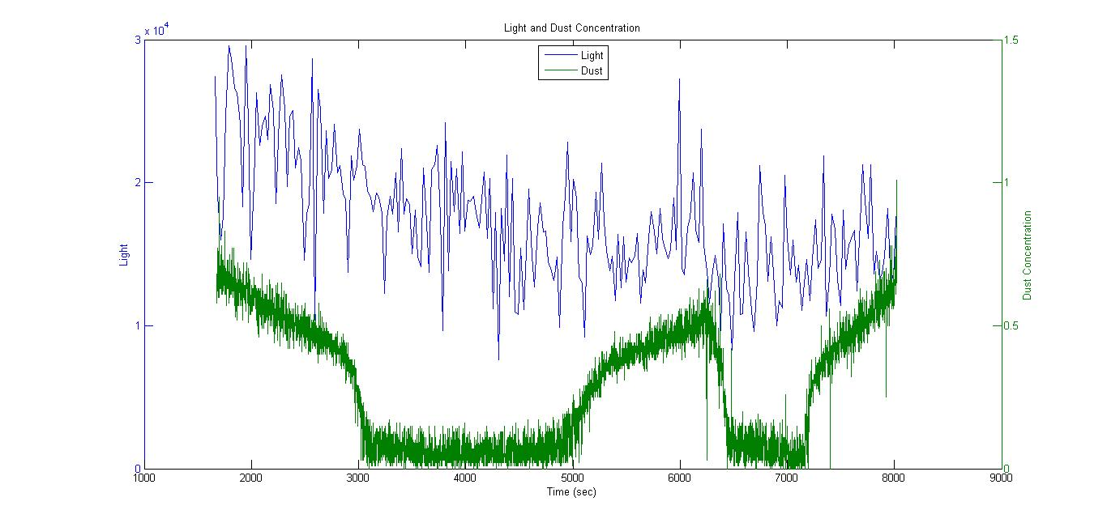
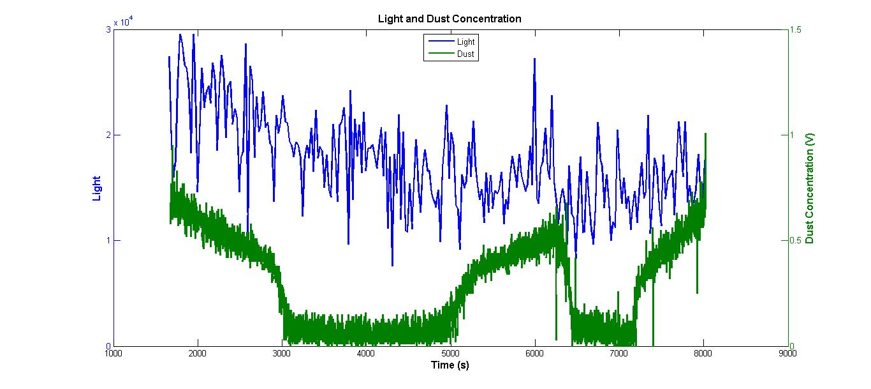
Spring Dust Module: IR Light

Slide 10
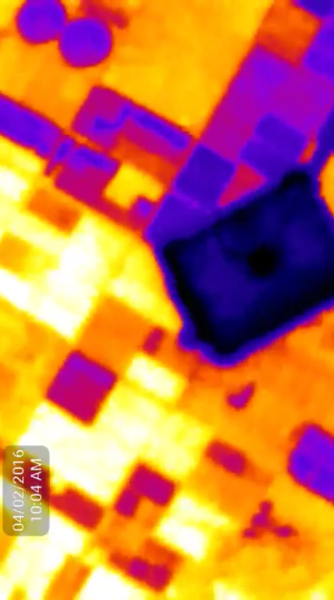
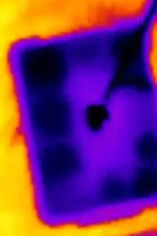
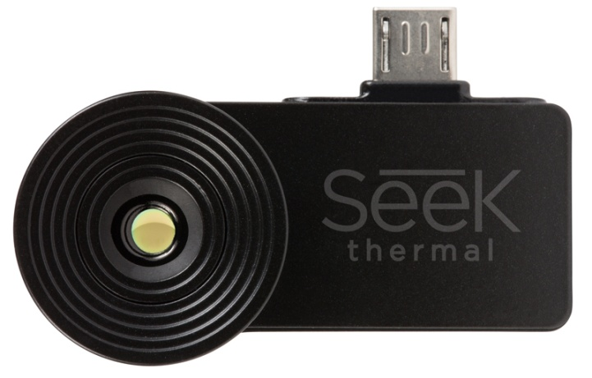
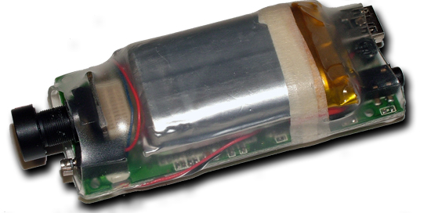
Cameras
Seek ($250)
HD Wing ($37)

Slide 11


Acknowledgements
Dr. Tom Sharp

Slide 12

Questions?

